Slide 1
Time Savers w/WebNavigator 8.6

Slide 2
Programming a study…

Slide 3
Spend some time up front…
Or time on the back end may be disastrous

Slide 4
“Garbage In – Garbage Out”

Slide 5
Review the survey
Ask Questions…
Logic
Spelling
Intent
Pronunciations

Slide 6
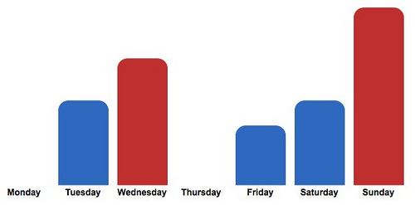
Run test data…
check it…
with sample elements even!

Slide 7
We have three very good programmers.

Slide 8
Let’s avoid these…

