Slide 1
Time Savers | MAXimum RePortal
2014 Users Conference | Las Vegas NV

Slide 2
Summary
Presented By: Brian Carson, Director – IT/DP, MAXimum Research Inc.
Developed By: Brian Carson
Overview:
The MAXimum Research RePortal is a webSurvent study that resides on our local CfMC machine. The purpose of this survey is to allow all members of the projects team; PDs, Programmers, Sales, & Phone Room Staff to run a large variety of reporting scripts created over the years, without needing command line access.
The survey is ever changing and growing, and over the past 6 months has doubled the number of reports available while also cutting in half the requests to the DP team for counts, data, reports, etc.
What follows is a quick look at the interface, a few of the currently available options, and a behind the scenes look at how it all comes together.

Slide 3
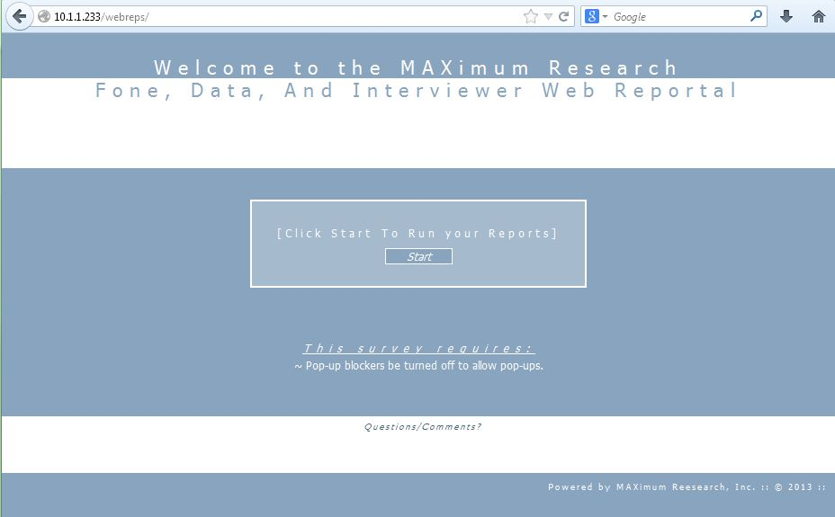
What is the RePortal?
A: MAXimum Research’s Report Portal - RePortal

Slide 4
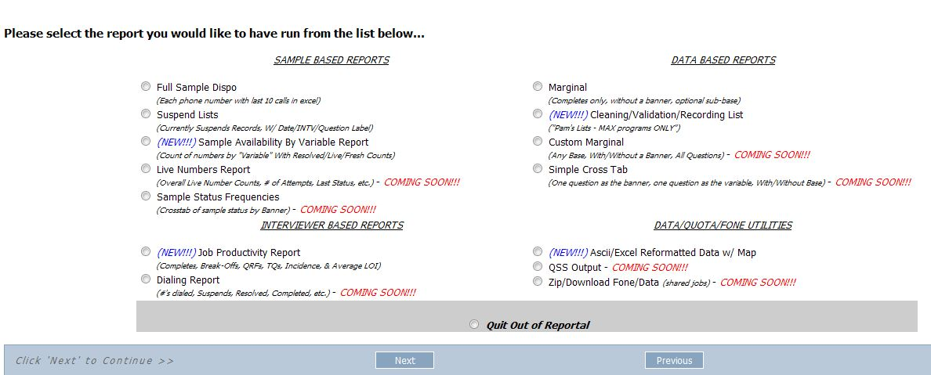
What is the Reportal?
Users are prompted with an ever growing list of reports available. New and Coming Soon Reports are also listed.

Slide 5
Reportal Example: Sample Availability
The Sample Availability Report is probably the most widely used report. It can be used to show how sample is preforming, and where more may be needed.
The “Variable” can be anything in the sample file:
Market Location
State Code (5121.2)
File Number (We sequentially number each file we receive in 66.4)
Basically anything!

Slide 6
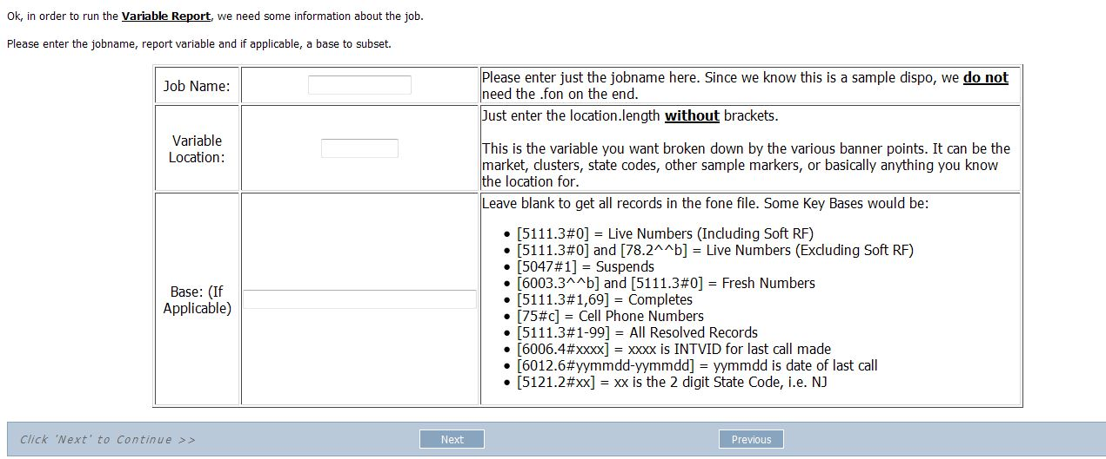
Reportal Example: Sample Availability
The User is first presented with a screen to enter the information needed for the report to properly run:

Slide 7
Reportal Example: Sample Availability
After filling in the information needed, the next screen confirms they have everything needed:
After clicking “Next” the system will run the report and then show the use a link to download the file.

Slide 8
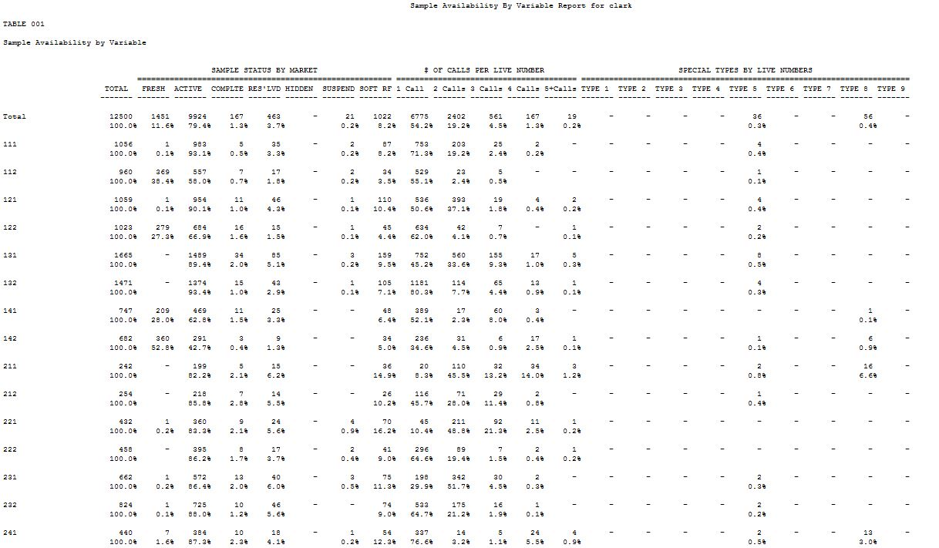
Reportal Example: Sample Availability

Slide 9
Reportal Example: Interviewer Productivity
The Interviewer Productivity Report is mostly used by our phone room staff. It is used to show how interviewers perform on a job, either overall, or on specific days.
The user simply enters the jobname, and if a date is needed, the date(s)

Slide 10
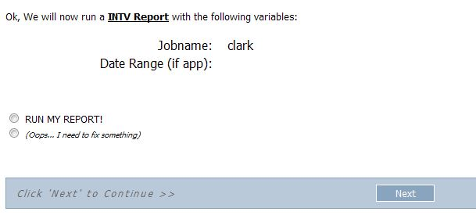
Reportal Example: Interviewer Productivity
Again, the system will confirm your selection before processing the report.

Slide 11
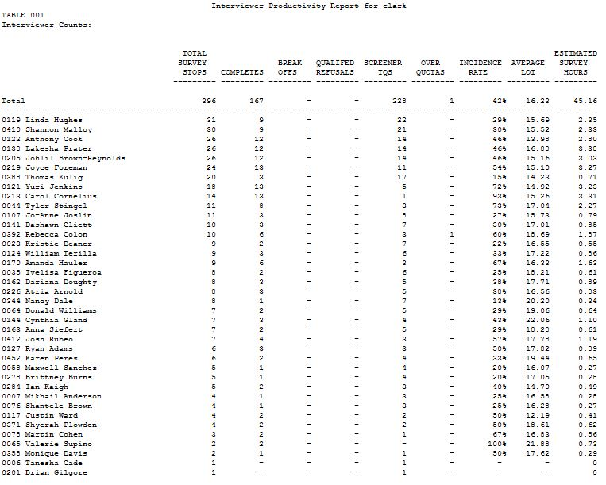
Reportal Example: Interviewer Productivity
The end result will show you detailed information about each interviewer on the project. This report doesn’t show dialing though. It is purely a DATA report.

Slide 12
Reportal Example: Easier “Reformat”
The example is a way for PDs to run basic ascii/csv data for a job, without having to understand how reformat works. We have taken a standard reformat run and saved the spec. From there, we tweaked the common options to look for a @def switch.
The resulting script makes it quicker for all to reformat data to client specifications.

Slide 13
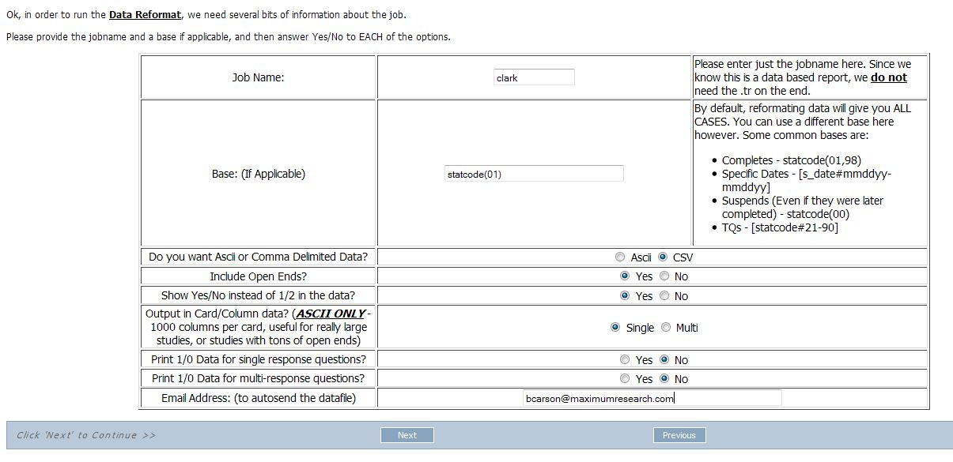
Reportal Example: Easier “Reformat”
The user simply selects the options they want reflected in the data:

Slide 14
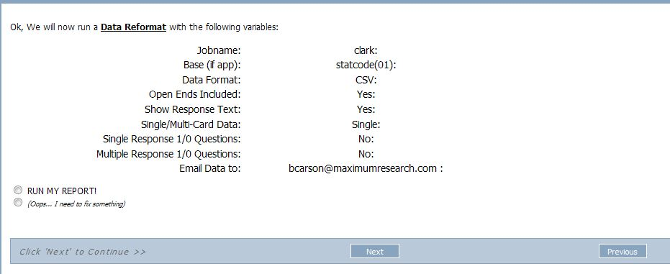
Reportal Example: Easier “Reformat”
As always, they are prompted with a confirmation screen, showing their selections and then a link to download the file(s)

Slide 15
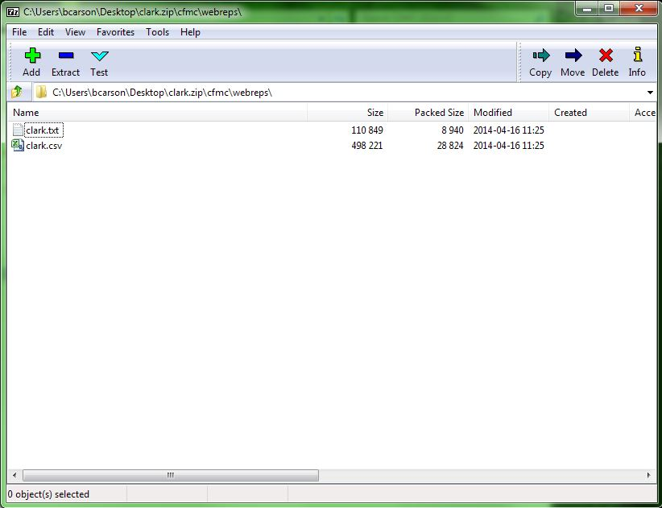
Reportal Example: Easier “Reformat”
If an email address was also specified, the files will be emailed and a link to download will be shown.

Slide 16
How Does it Work? - 3 Steps…
Step 1 - Capture inputs via CfMC webSurvent survey
Step 2 - Write out “command line” commands and execute**
Step 3 - Display download link in survey
**Special thanks to Jim Ratto for all the debugging help!

Slide 17
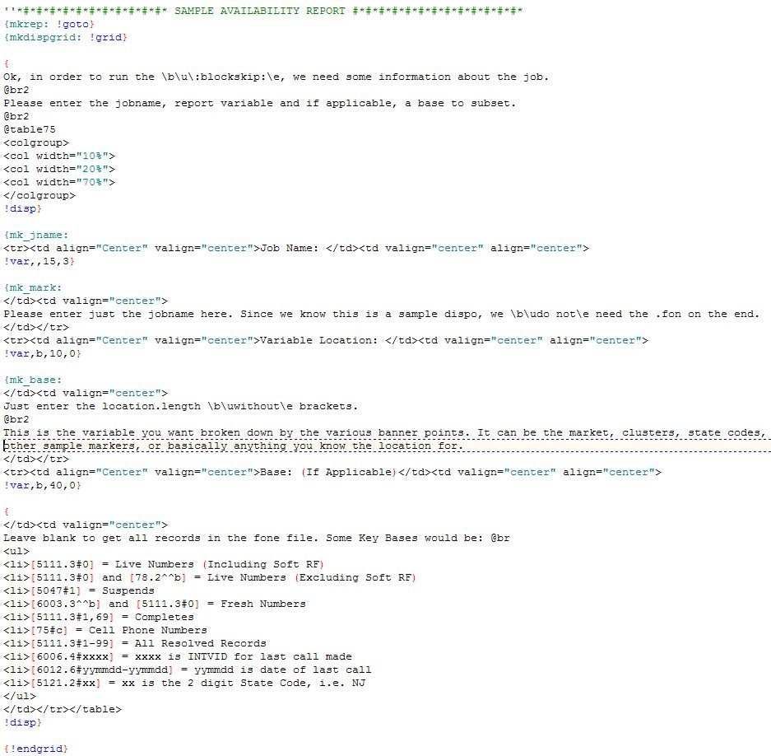
How Does it Work? – Step 1
Step 1 - Capture inputs via CfMC webSurvent survey

Slide 18
How Does it Work? – Step 2
Step 2a - Write out “command line” commands and execute
The @def in the spx are defined from the mentor command line

Slide 19
How Does it Work? - 3 Steps…
Step 3 – Copy files to web area and display download link in survey.

Slide 20
Bugs/Issues/Wishes
Some of the bugs/issues we seem to have are:
Cookies cache old copies of reports, so they don’t always update
If there is an error while compiling the spec, it doesn’t tell you.
(I am in the process of adding a link to download the listfile from the compile)
You still need to know a little CfMC code to fill in bases/variable locations
I hope to fix this by changing the !var questions into dropdowns w/ other for the “most common” requests
There are not restrictions in place to limit what users can/cannot run. Everyone can run anything on any job.
I plan to create a “sample file” with user info, and only allow those users access to those reports. They will still have access to all projects though.
The biggest wish I tend to get from internal staff is:
When can you make one of these for clients…

Slide 21
Thank You!

