Slide 1

WHEN QUOTA MATTERS
_____________________
CfMC Directions
2014 Users Conference | Las Vegas NV

Slide 2
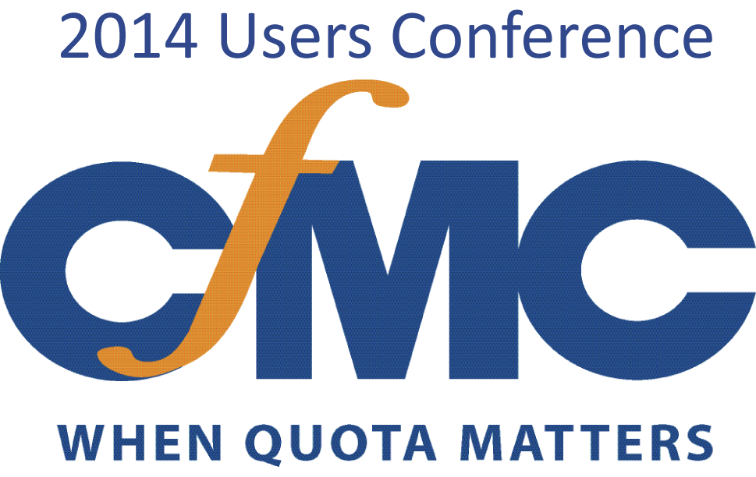
2014 Users Conference
Customers
Soon-to-be Customers
----
Sponsors
----
Employees
Notes:
Danny – brings so much continuity and wisdom to this event and to our decision making process. Today he wears two hats, both focused on the Customer Experience – CTO & QA – Ensuring we are making the right products and producing quality outcomes for you.
Charles Beauvais – who has been leading engineering and now transitioning to Chief Architect with the advent of Jason Kagel.
Jason – joins us from Autodesk and brings a hard to find combination of high level thinking, process enablement and roll-up your sleeves ‘get it done’ that we are all benefiting from. I hope you all have a chance to spend time with him. He wants to spend time with you.

Slide 3
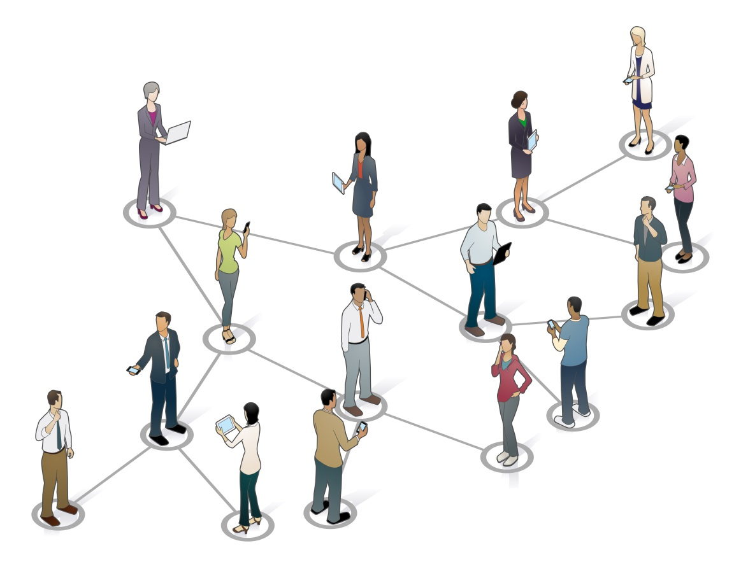
CfMC Directions
Year in Review
  What we see
  Trends we’re following
CfMC Focus
  Strategic Initiatives
  Roadmap

Slide 4
The Year in Review
Customer Engagement
Industry Conferences
Horizon Gazing

Slide 5
The Industry Debate – OurTake
Survey research isn’t going away
Phone interviewing isn’t dead
….and is a huge competitive advantage for many of you (more later)
Cell Phones / Smart Phones → central to every strategy
Multi-modal surveys → technology challenged
Big Data → not this year, but coming

Slide 6

Phone | Productivity Matters
Higher return on labor costs
    Faster, smarter dialing → More completes per hour
    Workflow enablement → Eliminate manual steps & labor costs
More rapid quota attainment
    Better targeting → Phone delivers high value demographics
    Better control → Real time operational refinements
Notes:
Open ends can be recorded and transcribed

Slide 7

Phone | Compliance Matters
PHONE IS INVASIVE & EFFECTIVE
→ that’s why Howard is here
Cell phone handling in v.8.7.1
  Dialer
    Sample can combine Cell & Land records
    Dialer handles appropriately
  Sample - easily mark records as Cell
    Real time - while on phone with respondent
    Off line - in a batch process.
Notes:
Open ends can be recorded and transcribed

Slide 8






Device Aware Data Collection
DEVICE DETECTION
OPTION A
OPTION B
1 Program | N Style Sheets
Multiple Programs
PROGRAM
PROGRAM
PROGRAM
RENDER
different style sheet
by device type
RENDER
different survey
by device type
Respondent Data
  Single quota management
  Single respondent data set
Respondent Data

Slide 9
Multi-Modal Survey Operations
Sample
Survey Modes
Time
Q. How to manage the data collection process
to make best use of
  Sample
  Time
  Budget
Q. How to build a data collection platform that enables fielding any type of survey?

Slide 10


Cost Management
SAMPLE
QUOTA
SURVEY METHOD
$
WEB
$
PHONE

Slide 11
Sample Management Across Modes
SAMPLE
SAMPLE MANAGEMENT
& OPERATIONAL CONTROL
BEST PRACTICES FOR COMPLEX, HIGH END, HIGH THROUGHPUT, MULTI-NATIONAL STUDIES
REQUEST & MANAGE
Requirements | Quota Status | Operational Control
CONNECT
Predictive Dialing | IVR Screening | Inbound - Outbound Call Handling
COLLECT
DATA COLLECTION
MULTI-VENDOR
MULTI-MODE
OnLINE
OnIVR
OnDEVICE
OnPHONE
OnSITE
DATA TRANSFORMATION
COMPLETE
Data Coding | Tabulation | Voice-to-Text Conversion I/F
DATA ANALYSIS
RESPONSES

Slide 12


Agile, Flexible Operations
12
Sample
Preferred contact method
Email
Phone
Address
Email Invitation
Outgoing Call
PAPER Survey
WEB Survey
URL
PHONE #
In-coming Call
Redial
Call back
IVR Screen
IVR Survey
CATI Survey
Responses

Slide 13
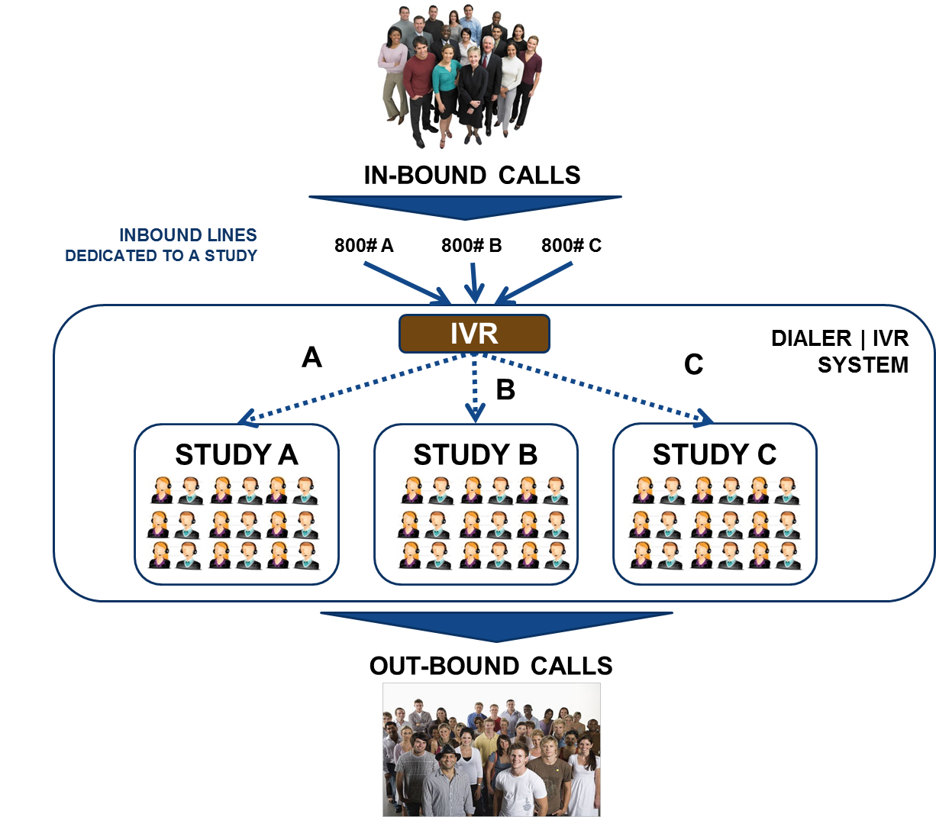

New in Release v.8.7.1

Slide 14
What We’re Following (Industry Trends )
Phone Research - stabilized
    → Now ‘right sized’ in the marketing mix
Data Collection - more distributed operations
    → Greater use of contractors
    → Greater need to handle a mix of vendors

Slide 15
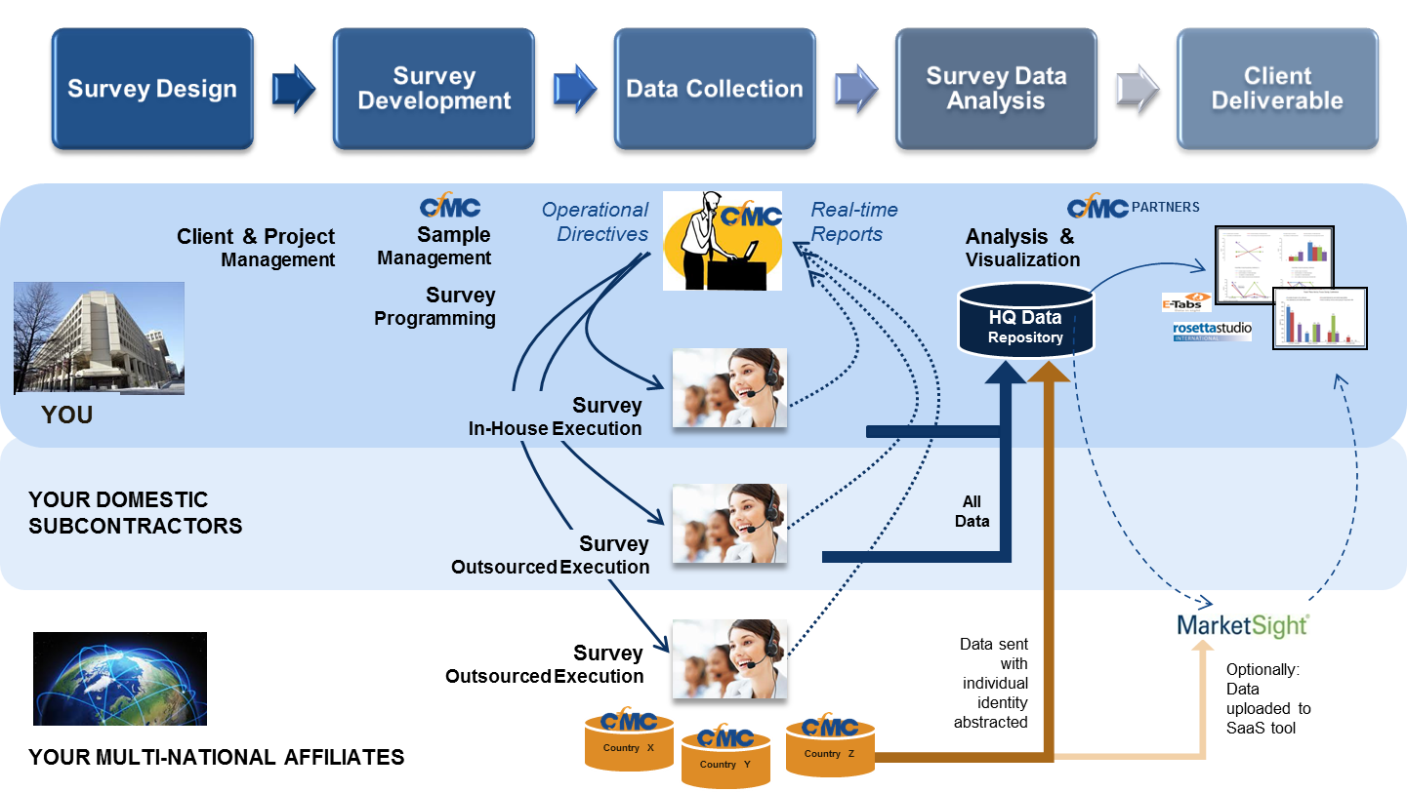
Distributed Data Collection
…. often spanning multiple geographies & organizations.
Notes:
Our solution: enables creation of very complex questionnaires and provides insight and operational control across all collection modes. The integration of our predictive dialer and IVR capabilities enables users to build highly configurable operations
Unlike competitors: who cannot provide centralized control of sample management and on-the-fly changes without disruption to operations, adding to the costs and time to the data collection process.
The Benefit: users gain the flexibility to re-optimize their high end data collection process in real-time, address evolving business needs, and match respondent preferences for interview mode while ensuring project completion in the shortest time and using the fewest sample records

Slide 16
Our Focus
Strategic Initiatives
Solution Roadmap

Slide 17
CfMC | Directions
CATI Operational Performance
Flexible Operations
Sample Management
One Platform, Many Modes
Real-time control
Mixed Vendors
In-House, Outsourced
Distributed Operations

Slide 18
CfMC Solution
Core Software
Applications
SURVENT Platform
Hosting & Application Management Services
Best Practice
Support & Services

Slide 19
Services | When you need them
Programming | Tabulations | Training/Best Practices
Survey Programming – Mobile, Multi-Language, Advanced Ad/Media/Pharma Conjoint/Choice Complex Quotas TrueSample™ Integration Panel Integration Sample Management Survey Hosting Third-Party Integration Recruit and Time Scheduling Product Test and Central Location Testing (CLT) | Cross Tabs Production Reports Data Files Open-End Coding Data Cleaning & Manipulation Data Entry Data Conversion Multi-Source Data Aggregation | Sample Management Shop Management Multi-Modal Survey Programming Process Automation Quota Set-Up and Management Multi-Mode Operations Data Collection Dialer Optimization Survey Operations Management Tabs

Slide 20

NEXT: Sample Management
CATI
PLUG IN
DISPOSITION CODING
SAMPLE SOURCING
NOTE: All forward looking statements are shared to foster discussion/input & subject to change.
STREAMLINED SAMPLE PROCUREMENT
Sample acquisition via Fulcrum marketplace
AAPOR TRANSPARENCY INITIATIVE ALIGNMENT
Map CfMC codes to AAPOR codes
Create Data Sets enabled for AAPOR Reporting
EASIER OVERFLOW / OUTSOURCING
    Drive Sample for Call Center operations
    Use existing questionnaire as interviewing interface

Slide 21
Web Survey Integration
Interviewer’s perspective
Once there is a connected call, a pre-loaded contract record and questionnaire is presented to interviewer
Supervisor can adjust sample ‘flow’ via the CfMC platform
Supervisor can gather call metrics during and after the survey via CfMC
Dialer acquires new number and dials it
The interviewer conducts the interview using the Web Survey Tool.
Data is updated into both systems
Notes:
This slide is a build – each click will expose more of the information.
Very simple workflow (from the interviewer’s perspective) – Call comes in, link appears (including embedded data) interviewer can click on the link and be presented with a browser window into Web Survey Tool survey. Interviewer uses Web Survey Tool to walk the respondent through the survey questions. All things like suspend/resume are dealt with via Web Survey Tool system. CFMC captures all of the call data and controls the flow of sample during the study.

Slide 22
THEN: Operational Control
CROSS STUDY CALL BLENDING
CLOUD DEPLOYABLE
OPERATIONAL DASHBOARD
NOTE: All forward looking statements are shared to foster discussion/input & subject to change.
CALL CENTER Real Time CONTROL
Productivity, Quota Attainment, etc. made visible & actionable
CLOUD COMPUTING PLATFORM SUPPORT
Amazon EC2, Microsoft Azure, ….
MULTI-STUDY Inbound CALL HANDLING
    1: Many …..One interviewer eligible to take calls from multiple studies

Slide 23
HORIZON: Operational Control
COMPOSITE SOLUTIONS
APPLICATION HEALTH MONITORING
DATABASE
NOTE: All forward looking statements are shared to foster discussion/input & subject to change.
BETTER DATA ACCESS
Via an open, secure, and extensible platform
Redesigned Operational Control
STREAMLINED WORKFLOWS
  Published RESTful API 1.0 enables cross-vendor business process enablement
GREATER RESILIENCE
    All major services can be checked and remedial actions taken to maximize availability

Slide 24

CfMC | Directions
CATI Operational Performance
Flexible Operations
Sample Management
Distributed Operations
WHEN QUOTA MATTERS

Slide 25
www.cfmc.com
Mary McDougall | mmcdougall@cfmc.com

