Slide 1
Best Practices – Compliance Techniques User Panel
2014 Users Conference | Las Vegas NV

Slide 2
User Panel – Best Practices/Compliance
Jim Ratto – CfMC
Moderator
Brian Carson – Director IT/DP – Maximum Research
Do Not Contact Lists
Tim Alex – Owner – The Alex Group
Email Compliance
Ed Ledek – President – Key Research Solutions
Dealing with Cell Phones

Slide 3
Best Practices | Compliance Techniques Self Updating DNC Lists – Brian Carson @ MAXimum Research
2014 Users Conference | Las Vegas NV

Slide 4
Summary
How MAXimum Research utilizes DNC Lists to remain compliant
Via (web)CATI scripts & “Self Removing” Web Survey
Cronjobs and .csh files to auto-process records nightly
Overview
While Market Research is exempt from the National DNC List, many companies like to keep an internal list anyway, to cut down on complaints from respondents.
MAXimum Research is no different. This presentation will take you through the processes used, in the hopes to show others how easy the process really is.
Presenter
Brian J. Carson, Director, IT/Data/Web Services
Held almost every position in Market Research, started as an interviewer in 1996. Worked for 6 different MR Companies over past 18 yrs. Met my wife at the first one. Been attending CfMC Users’ Conference since 2001, Committee member since 2006.

Slide 5
Session Outline
(web)CATI Script
Capturing Info
Processing
Updating DNC List
Daily Cron
Fonebuld Options
Nightly Rebuilds
Self-Removal Web Survey
Capturing Info
Processing
Daily Reporting
By Job
By Interviewer

Slide 6
(web)CATI Scripts
Introduction Code
Confirm Addition to DNC List
Status Number

Slide 7
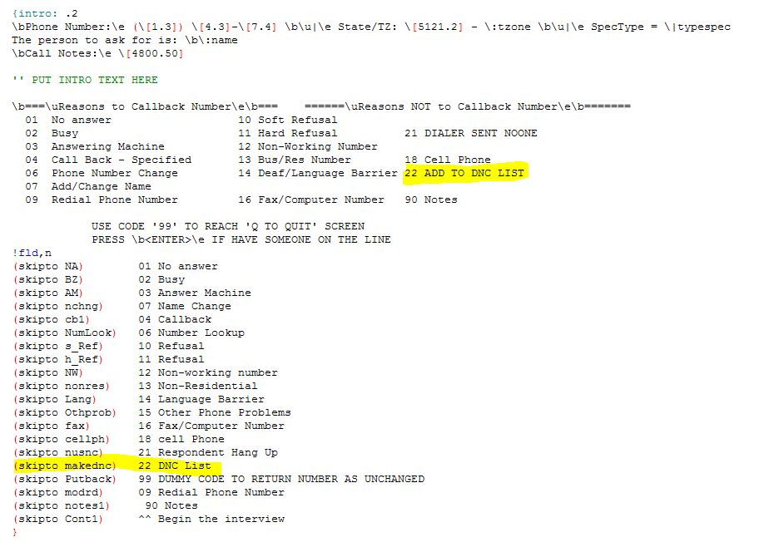
(web)CATI Scripts
Added code to the survey introduction in master shell

Slide 8
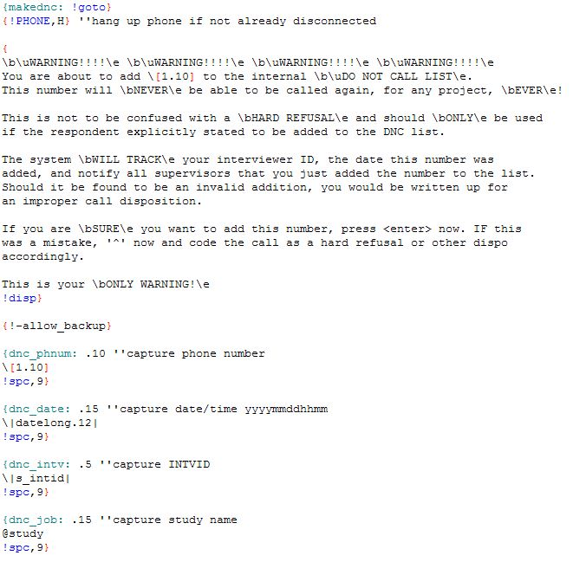
(web)CATI Scripts
Confirm INTV wants to do this and capture info from study.

Slide 9
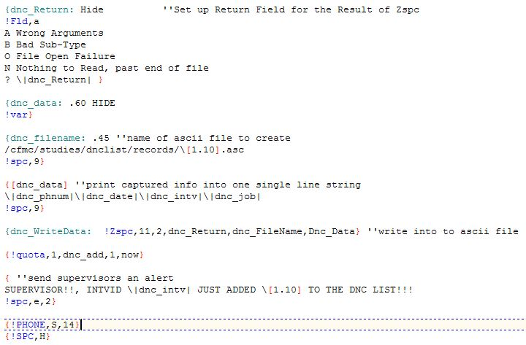
(web)CATI Scripts
Process collected info and create ascii record for later DNC addition.

Slide 10
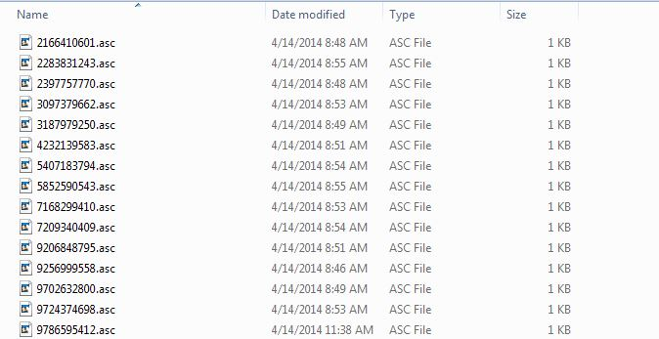
(web)CATI Scripts
The end result will be a collection of ascii files on the system, waiting to be processed into the DNC tr file.

Slide 11
Self Removal Web Survey
Link located on company website, so respondents can remove themselves
Captures only a telephone number
Process into ascii file for later DNC addition

Slide 12
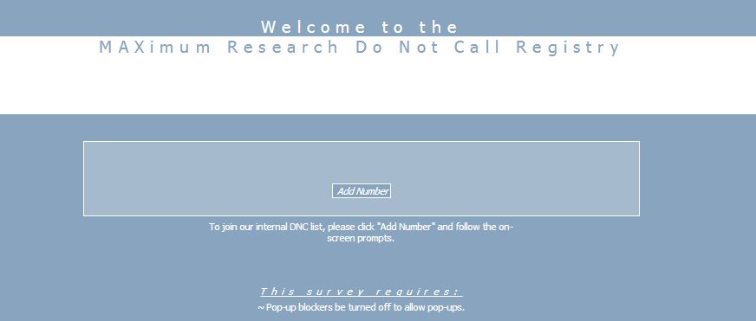
Self Removal Web Survey
To facilitate respondent’s ability to remove themselves from calling lists, we took the same basic code and added it into a web survey. The link is easily accessible via our company website.

Slide 13
Self Removal Web Survey
Very simple, 1 question survey for respondents to add their phone number to the DNC list.

Slide 14
Self Removal Web Survey
From there, the behind the scenes process is identical, except the ascii file will not contain a specific INTV ID or Jobname

Slide 15
Processing ASCII Files Into DNC
Runs Nightly between Shifts
Add records to Indexed TRFile
(re)Build FONE files with DNC List checks

Slide 16
Processing ASCII Files
Taking the daily batch of ascii files and adding them to the DNC List is a simple 2 step Process.
Append the ascii files to the master DNC tr file
Remove ascii files from folder

Slide 17
Processing ASCII Files
The script is executed via a cron, nightly at 2am.
Shortly after, all current jobs are run through the “fonerun” process, to ensure any new numbers are removed from all jobs
Our default shopfile also contains the DNC File location, making sure all sample added is checked first.

Slide 18
DNC List Reporting
Daily Reports By:
Interviewer
Job

Slide 19
DNC List Reporting
To make sure our staff is properly using the idea behind a DNC list, 2 sets of reports are generated nightly, as part of our nightly batch reporting suite. These 2 reports give counts on NEW DNC entries from the previous shifts. There are reports that show both:
Counts by Interviewer, to monitor how many each interviewer is adding
Counts by Job to make sure the supervisor is overseeing his/her responsibilities

Slide 20
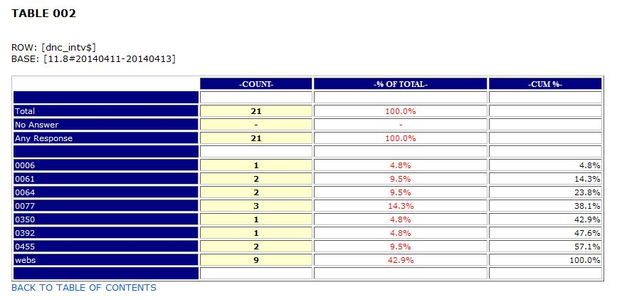
DNC List Reporting
Interviewer Report – Allows QA Department to monitor DNC entries by interviewer.
We have found new employees need extra help understanding the differences between a Soft Refusal, Hard Refusal, and DNC Request. This report is particularly useful in that aspect.

Slide 21
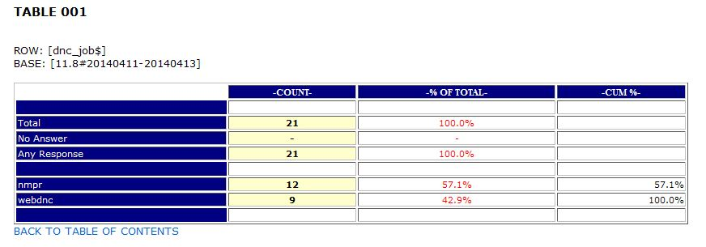
DNC List Reporting
Supervisor Report – Simply shows the total DNC additions by Project Name.

Slide 22
Questions or Comments?
Thank You!

Slide 23
Email Compliance/DNE Tim Alex
2014 Users Conference | Las Vegas NV

Slide 24
Summary
Outcome | What the Audience will Learn to Do
Review CAN-Spam Act of 2003
Some do’s and don’ts of mass emailing
Problem resolution
Abstract
Compliance doesn’t mean you aren’t going to have problems. It WILL help resolve problems.
Presenter
Tim Alex
Tim started working in market research, and working with CfMC software, twenty years ago as a telephone center manager in Kansas City. In the last twenty years he has been involved in facility management, sales, project management and I.T./programming. He is currently self-employed, mostly programming WebSurvent, WebCATI, and Survent.

Slide 25
Review of CAN-Spam Act
Compliance points
A usable unsubscribe option below message
Honored within 10 business days
Accurate from lines
Relevant subject lines
Legitimate physical address
Sending behavior compliance
No open relays
No false headers
At least one sentence

Slide 26
Some tips
Do’s
Keep subject line short
Focus on the respondent benefit
Tell the respondent why
Test different subject lines
Add a privacy policy link
Use spam checking tools
Don’ts
Don’t distract respondents
Don’t go overboard with personalization
Don’t use personal FROM addresses
Don’t use exclamation points!
DON’T USE ALL CAPS

Slide 27
Be prepared for problems
Set client expectations before studies
No purchased lists
Opt-in or relationship only
Why is the respondent receiving this email?
Documentation from client may be necessary
Keep and maintain your own DNE, even if you use a service
Maintain a good relationship with ISPs or the service you use.
FOLLOW THE RULES, EVEN WHEN IT ISN’T CONVENIENT!

Slide 28
Cell Phone Handling

Slide 29
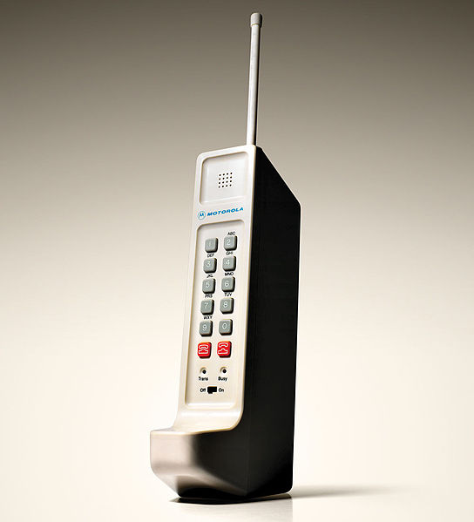
“Not My Job”
We cannot take that position
Well, no…but yes!

Slide 30
It’s Our Job
Regardless of any…
Definition
Expectation
Desire
Norm

Slide 31
Using Lists/Dialing

Slide 32
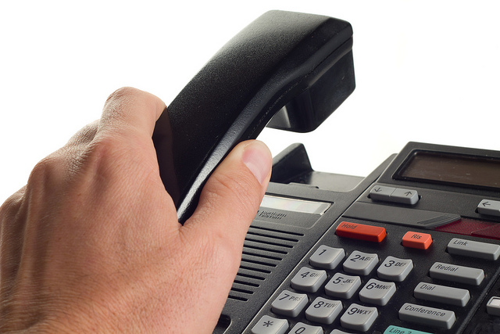
You make the call
Up front
In the middle
At the end

Slide 33
Better Safe Than Sorry

Slide 34
QUESTIONS?

Slide 35
Lunch | Special Interest Groups
DOCUMENTATION
INTEGRATIONS
NAVIGATOR
CLOUD BASED DEPLOYMENT
SECURITY & STANDARDS
DIALER
TRANSPARENCY

