Slide 1
Best Practices for Rotations May 29, 2015

Slide 2
Best Practices for Rotations
Lisa Mangone-Jackson Client Success/Best Practices

Slide 3
What will we talk about?
How to rotate FLD list items
How to keep the rotation order
Using Rotation Seeds
How to record the rotation order
How to rotate Grids
Rotations with Include/Exclude items
How to rotate attributes evenly across pages (Qref)
Notes:
Hello everyone. Welcome to our Rotation Best Practices webinar.
With software development, your programming should develop as well.
Today we are going to talk about…
Why a FLD,R should no longer be used on FLD list items
How to keep the rotation order
Rotation order is very important especially on web studies where your client wants lists or attributes rotated in the same order
Using rotation seeds will ensure that you keep and record the rotation orders. You can control the rotation order using seeds.
As of today, Rotating grids cannot be done by just using a !rotate. But there is a way to rotate grids that I will go over.
Rotating items with includes and excludes can be tricky if there aren’t the same number of items being rotated. I’ll talk about how to ensure the items are rotated the same.
And there are times where you are given a long attribute list and you client does not want scrolling on the page. Rotating long attributes across several pages can be done using a Qref command and I’ll talk about how to use these commands.

Slide 4
Why rotations are used
Rotating list items or questions is a best practice to keep an interviewer or respondent engaged and their interest level high.
Using rotations is a great way to eliminate order bias.
Help me!
I can’t read another boring brand list
Notes:
Why do we use rotations?
We do not want an interviewer or a respondent bored or in this case falling asleep. We want to keep them engaged. Rotating the order of list items or questions keeps their interest high because they will not anticipate a question being read or shown in the same way each time.
We want the interviewer to not get used to reading lists or attributes in the same order. Voice levels and energy levels make a difference.
For webCATI studies, you can put an interviewer into practice mode and that will disable the rotations by default. This is good for testing and briefing.
Also, using the DBUG interviewer ID will disable rotations as well.

Slide 5
Rotation Types
Scramble - Complete randomization of order
(e.g., 2/4/3/1, then 4/1/3/2)
Recommended Type
Flip - First-to-last, then last-to-first
(e.g. 1/2/3/4, then 4/3/2/1)
Regular - First-to-last, advancing the start point with each iteration
(e.g., 1/2/3/4, then 2/3/4/1)
Do not use unless necessary
Notes:
What are the rotation types?
A Scramble rotate gives you a complete randomization of order and is our recommended type to use 99% of the time.
A Flip rotate is fine to use with a couple of items. It will flip the items first-to-last and then last-to-first. A Flip rotate can also be used to mix high-to-low and low-to-high scales if there is concern about bias. But be more careful using it, if you are doing something like a horizontal rating with a header row in a grid, you will need to remember to flip that too.
We never recommend a Regular rotation unless it’s absolutely necessary. This is not a true rotate or randomization of order. It will rotate through the list from first-to-last but advance the starting point by 1 for each iteration.

Slide 6
Rotation Syntax
{!ROTATE, subtype, # per group, controlling label or data location }
{!ENDROTATE }
{!GROUP, # in block }
{!FIX, # in block }
Notes:
What is the rotation syntax to use?
The !ROTATE command begins the rotation block. The subtype and controlling label or data location should be used but the # per group is optional. An !ENDROTATE is required to end the rotation block.
The !GROUP command keeps N items or questions together in a rotation. This always follows a !ROTATE command. The # in block is optional. If N is specified then that number of items or questions cannot include other rotate commands. If N is not used, then all items or questions until the next relevant Fix, Group, or Endrotate command at the same rotate level are grouped.
The !FIX command fixes the position of the next N items or questions. This always follows a !ROTATE command. The # in block is optional but we recommend using it. If N is specified then that number of items or questions cannot include other rotate commands. If N is not used, then all items or questions until the next relevant Fix, Group, or Endrotate command at the same rotate level are fixed.

Slide 7
FLD type question rotations
Old
Recommended
FLD,R
Need to use the (!) option to keep items from rotating
Deprecating
Rotate/EndRotate
Nest rotates
Use Group/Fix
Record the rotation order
All rotation types are allowed
Maintain rotation list order across a multitude of questions
Notes:
Using a !FLD,R to rotate list items is very limited in what you can do with it. You cannot use groups or fixes or record the rotation order. We are actually deprecating it and it’s no longer taught.
With our recommended way you have much more flexibility. You can maintain the rotation order by using rotate seeds. You can have nested rotates while using Group and Fix statements. All rotations types can be used and you can maintain a rotation list order across a multitude of questions. This method has actually been around for a few versions but this is now our best practice to rotate list items. With surveys migrating more to the web, clients are wanting more control over rotations.

Slide 8
Keep rotation order across questions
Notes:
Notice in this example, the Rotation order of the Brands vs the Rotation order of the Brands in the Follow up Attribute table. Keeping the rotation order Works the same with individual questions or attributes on the screen as well.

Slide 9
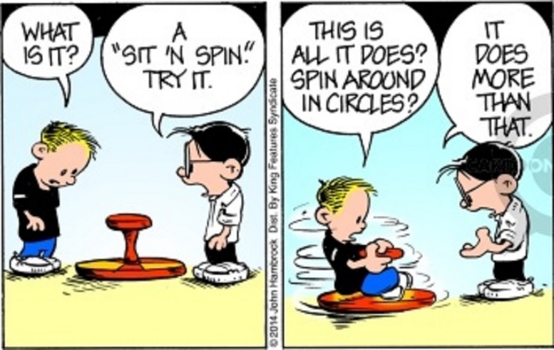
Rotation Control
Using rotations with a !Rotate gives you complete control over which list items or questions are rotated Group list items or questions together Fix or keep list items or questions from rotating Using nested rotates is easier for list items Rotate seeds are required for rotating list items but recommended for rotating questions
Notes:
As stated before with using a !FLD,R you have no control over how your list of items rotates. Using a !rotate gives you complete control. You can use Groups/Fixes extensively within lists. Nested rotations within lists is a lot easier to program.
Using rotation seeds help with the control and the use of them is required for FLD lists. They are not required for question rotation but we strongly recommend using them. It’s much harder getting the rotation order without using rotation seeds.

Slide 10
Rotate Seeds
Rotate seeds are used to rotate items or questions in a specific order
Random 10-digit value is generated by an algorithm
Use the value of a specific seed to control the order of rotation
Never use a seed value over 5,000,000,000
Good for odd requests where 2 brands can never be displayed together, for example.
Used to keep the order of rotation for:
List Items
Questions
List Items in the same order as a set of questions
Notes:
Rotate seeds are used to rotate items or questions in a specific order.
They are 10-digits as the default and they are created by an algorithm. Using them Keeps the order of rotation.
You can feed the value of a custom seed into the rotation using an Expression, VAR,A or SPC,9 statement.
Never use a seed value over 5,000,000,000 because you will always get the same pattern of rotation.
Using custom rotation seeds allows you to rotate brands in a way where say brand 3 and brand 4 can never be together, for example. You can do this by rotating Gen statements into a FLD question. Look at the data and if all is ok where 3 and 4 are not together move on but If 3 and 4 are together, Blank out the question and try again until you get a sequence where 3 and 4 are not together. Whatever that sequence is, you can feed that that seed in to rotate properly.

Slide 11
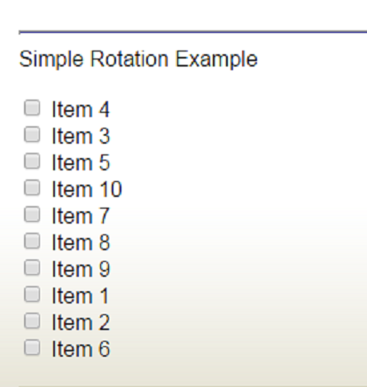
Simple Rotate Example
{ ROTSEED: HIDE !VAR,N,10,10 } { QROT: Simple Rotation Example !FLD,,10 !ROTATE,S,,ROTSEED 01 Item 1 02 Item 2 03 Item 3 04 Item 4 05 Item 5 06 Item 6 07 Item 7 08 Item 8 09 Item 9 10 Item 10 !ENDROTATE }
Notes:
Here is a simple rotate example:
Create a rotate seed – notice a length of 10 to hold the seed
Use the seed on the rotate statement
An endrotate statement goes after all items in rotation – last item in list before the ending curly brace
On the right is how the list will look on screen.

Slide 12
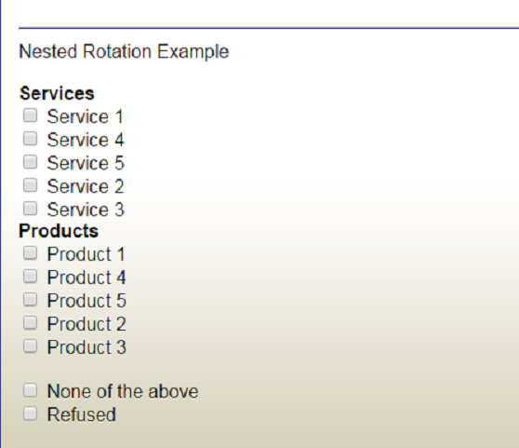
Nested Rotate Example
{ QROT:
Nested Rotation Example
!FLD,,10
!ROTATE,S,,ROTSEED1
!ROTATE,S,,ROTSEED2
!FIX,1
== <b>Products</b>
01 Product 1
02 Product 2
03 Product 3
04 Product 4
05 Product 5
!ENDROTATE
!ROTATE,S,,ROTSEED2
!FIX,1
== <b>Services</b>
06 Service 1
07 Service 2
08 Service 3
09 Service 4
10 Service 5
!ENDROTATE
!FIX,3
==
98 None of the above
99 Refused
!ENDROTATE }
Notes:
Here is an example of a nested rotate example. You need to create however many rotate seeds necessary and in this example I’m using 2 that are a length of ten.
Also notice this example has comment lines in it. These will need to be accounted for as well with Fix statements.
You can add as many group and fix statements as needed.
Make sure there are endrotate statements after each group of items rotating.
Add an ending endrotate statement after all items in rotation – last item in list before the ending curly brace
On the right is how the list will look on screen.

Slide 13
Capture Rotate Order
Rotation order is easily recorded in the data for list items and questions
{!Recode_Rotate_Order,<label>,[noblow] } captures the order of rotation for FLD items
{!-Recode_Rotate_Order} turns off the recording
{!Rotate_Order,<label>,[asked,noblow] } captures the order of rotation for questions
{!-Rotate_Order} turns off the recording
Capturing rotate order using Survent is comparable to capturing the order of mention using Javascript
Notes:
The rotation order is easily recorded in the data for list items and questions.
Both recording types require a question to store the results in and reference. The storing question for both needs to be large enough to hold all possible answers.
A FLD question length is figured out by the # of digits in each code * # of codes (1x5=5, 2x5=10, so on)
Question lengths are figured out by the # of questions in the rotation * # of digits in the # of questions (5 questions length=5, if 20 questions length=40 and so on)
The RECODE_ROTATE_ORDER command is used to capture the order of rotation for FLD list items.
Using the [noblow] option allows you to record only the first N items asked and by setting noblow it will allow the program to save that many items without blowing due to lack of space.
You should turn off the RECODE_ROTATE_ORDER command after the question to turn off the recording. If it’s not turned off, it will continue to record the rotate order of any rotating FLD list items.
The ROTATE_ORDER command is used to capture the order of rotation for questions. Both options (asked and noblow) CAN be used together.
Using the [asked] option allows you to limit the list to questions that are askable, for example: it is used to exclude generate or expression statements in the rotate.
Using the [noblow] option allows you to record only the first N questions asked, sets the variable length to the length needed for that many questions and will allow the program to save just that many questions without blowing due to lack of space.
KBA #292 shows an example of how to use the RECODE_ROTATE_ORDER and ROTATE_ORDER commands.
KBA #156 shows an example of how to use these commands with nested rotates.
KBA#161 is an example that captures the rotate order after data has been collected. It uses the Rotation_Order.qpx. You cannot capture the order if a FLD,R was used.

Slide 14
Capture rotation order in the data
Notes:
Here is an example of how the rotation order was captured in the data.
You can also use Javascript to capture the order of mention – It’s the setorder JS function. You can call it into the grid to capture the order of mention.

Slide 15
Rotating Grids
Create a hidden question to control which grid is chosen
Randomly rotate the # of grids
Choose a grid that hasn’t been seen and go to it
Ask Questions Then go back to choose another
End Rotation Process after all Grids have been chosen
Notes:
While you can rotate list items and questions, you cannot rotate grids with a simple rotate statement.
This is the flow that you will need to do with rotating grids. This can be as simple or complex as needed. You can also have nested rotating grids using the same logic concept for each part of the nested rotation.
The basic steps are:
1) Set up a hidden question to control which grid gets chosen
2) Use a Scramble Rotate to rotate the # of grids to choose
3) Choose a grid that hasn’t been seen and go to it
4) Ask all of the questions within the chosen grid and go back to the hidden question to randomly choose another grid to go to
5) Keep going through this loop until all grids have been chosen
6) When finished, create an endpoint to go to after all grids have been chosen and displayed

Slide 16
Rotating Grids – Example of Logic (Part 1)
{ PREGRIDCHK: !GOTO }
{ GRIDCHK: HIDE
!FLD,,3
1 Q1 Section
2 Q2 Section
3 Q3 Section }
{!ROTATE,S }
>REPEAT $A=1,2,3
{!IF GRIDCHK(<>$A)
!GOTO, PREQ$A }
>ENDREPEAT
{!ENDROTATE }
{!GOTO, ENDGRIDROT }
Notes:
The example in your spec will look something like this:
Set up a hidden question to control which grid gets chosen. This hidden question needs to hold as many grids necessary and needs to be set up as a multi-FLD question.
You then are going to use a Scramble Rotate, rotating the number of possible grids. You do a comparison saying if that grid has not been chosen yet , choose it.
Once a grid is chosen, use a !GOTO statement to go to that grid to ask the question(s).
Create !GOTO endpoint to go to after all grids have been rotated and chosen

Slide 17
Rotating Grids – Example of Logic (Part 2)
>REPEAT $A=1,2,3
{ PREQ$A: !GOTO }
{ Q$AGRID: !GRID }
{ Q$A:
Q$A Text
!FLD
1 Item 1 }
{!ENDGRID }
{ Q$AGEN: !GEN,A,GRIDCHK,$A }
{ Q$AGOTO: !GOTO, PREGRIDCHK }
>ENDREPEAT
{ ENDGRIDROT: !GOTO }
Notes:
Set up your grids with a !GOTO point after the Grid is chosen
Ask the question(s) in the chosen grid
Gen the correct grid code back into the hidden question to record that the grid was chosen
Set up a backwards !GOTO to go back to the hidden question to go through the logic to choose the next Grid. You do not want to use a RESET here because you do not want to blank out any codes already GENERATED into the hidden question.
Ensure that the ending point !GOTO question label is there to go to after all of the grids are chosen and asked.
KBA #160 has this example on rotating grids.

Slide 18
Rotates with Include/Exclude Options
Always rotate the same number of items Use GOTO statements if necessary as placeholders Rotates will not keep the order of rotation if there is not an exact match of items
Notes:
When using rotates with include/exclude options, you must rotate the same number of items. If you do not then the rotates will NOT rotate properly because of the mismatch of items.
You may need to use GOTO statements as placeholders to keep the same number of items rotating.
For instance, let’s say you have a multi-punch FLD list of companies that are rotating that includes an exception code of None of These as a choice that is fixed within the rotation. You then ask a follow-up question for each company chosen but need to maintain the rotation order. You will need to add in a GOTO statement within the rotation of the follow up questions as a placeholder for the None of These choice or else the companies will not maintain its order of rotation from the FLD question.

Slide 19
Rotate with Include/Exclude FLD Question
Rotate Order
Keeps rotation while including items mentioned above
Notes:
This example shows how an Include is used and an added Include List Item in the follow up question all keeping the same rotate order.

Slide 20
Why use Qref?
You can rotate a series of questions evenly across multiple grids.
When presented, the questions will be displayed evenly across the number of grids defined.
Using a Qref can get tricky if the questions are skip based as you need to figure out many questions and screens are needed.
Notes:
Why do we need to use QREF?
You need to use the Qref statements when you have a long list of attributes that need to rotate and you do not want scrolling on the page. You need to split those attributes up evenly across several pages to eliminate scrolling.
If, for example, you have 31 attributes and are displaying them on screens 1 through 5, then you will get 6 attributes on screens 1 through 4 and 7 on the last screen.

Slide 21
Qref Types
The syntax for !QREF statements is: {!QREF,<type>,<options> }
Qref Types:
N - To start a !QREF section, specify the number of blocks and questions
The maximum number of blocks is 20.
The maximum number of questions is 400.
{!QREF,N,<number of blocks to display>,<total number of questions>}
P – “Puts” the questions into the QREF Array
E - Ends a !QREF block
Ends the placement of the questions
G - “Gets” each of the QREF blocks/grids to display on the screen
{!QREF,G,<block number>}
C - Clears the current !QREF array
Notes:
The Qref Types are….(Read from slide)
The only optional type is the C – all others should be used. While you should clear the Qref array it’s not necessary unless there is a following Qref type of question. Then the array should definitely be cleared out.

Slide 22
Qref Example (Part 1)
{!QREF,N,5,50 }
{!QREF,P }
{!ROTATE,S }
>REPEAT $A=01,...,50 {ATTRIB$A: Attribute $A !FLD 5 Excellent 4 Very Good 3 Average 2 Fair 1 Poor } >ENDREPEAT
{!ENDROTATE } {!QREF,E}
Notes:
Here is an example of how to rotate attributes (questions) across multiple screens.
You use the QREF,N command to define the number of screens and the number of questions. In this example there are 5 screens with 50 questions
Use the QREF,P command to place the questions in the QREF array.
Set up your scramble rotate and attributes with the # of questions necessary
Use the QREF,E command to end the placement of the questions.
Finally, use the QREF,G command to present the questions to the respondent.

Slide 23
Qref Example (Part 2)
>REPEAT $A=1,...,5 (Number of Screens) Build your table structure (Headers etc) inside of a Grid
>REPEAT $B=1,...,10 (Number of Attributes per Screen)
{ QATTR_$A$B: !QREF,G,$A }
>ENDREPEAT
Close your table and End the Grid >ENDREPEAT
Notes:
The 1st Repeat is to define the # of screens (In this example there will be 5 screens each containing 10 attributes)
Build the table structure with your rating headers etc
The 2nd Repeat is to define the # of attributes per screen (In this example there will be 10 attributes per screen)
Get each specific QREF screen to Call In (In this example there are 5 screens)
Close your table and end the grid
KBA #257 shows this example as well

Slide 24
Rotation Odds/Ends
Use Resume_Here before any complex rotations of questions and grids along with Resume_Where_At at the end of the rotation.
When running RDG data on a FLD question with the list rotated, you must assign a weight to each part of the rotate options as well as the responses if you are weighting the responses.
This includes Rotate, Endrotate, Group, Fix, = comment lines
Give these a weight of 0 as a placeholder
Notes:
Using the !RESUME_HERE statement guarantees that all iterations of a given rotation will be re-executed when the interview is resumed.
Resume_Here: Interviews suspended after this statement will come back here to start. Often used at the beginning of a block of related questions, such as before a Rotate block. Use as many in a questionnaire as needed.
Resume_Where_At: Used after a RESUME_HERE to say “resume at the question suspended at” from now on. This is the default and need only be specified to turn off a previous RESUME_HERE. Use as many in a questionnaire as needed.
Running RDG data with a rotation on a FLD question requires a few things with the weighting. If you are weighting the question for any reason you must assign a weight to each part of the List.

Slide 25
Next Steps/Contact Us
This presentation can be made available upon request
Further training? Email: lmangone@cfmc.com
Upcoming events
UC
http://www.cfmc.com/events/uc2015/
Topics and papers
Webinars

Slide 26
Q&A
Notes:
We’ll open up the discussion with any questions?

